Slide 1
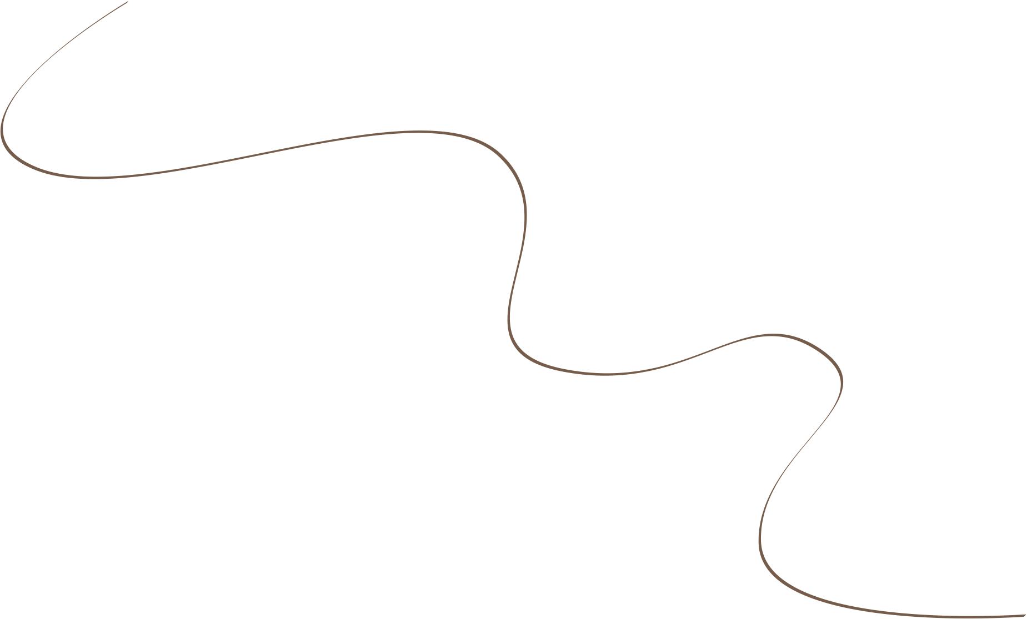
curev passion
SLIDE
Interior and exterior design to enhance everyday life.
/MNL
Custom and considered innovation to residential building,
Curev passion.
CLEAN PRESENTATION TEMPLATE
Created and designed by 荒唐梦.

Slide 2
curev passion
Create new concept.
Design has the power to pull people closer, guiding them visually so they can easily engage with your brand. It replaces confusion with clarity and brings understanding to those who encounter your work.
A designer who has served the industry for over a decade.
Created and designed by 荒唐梦.

Slide 3
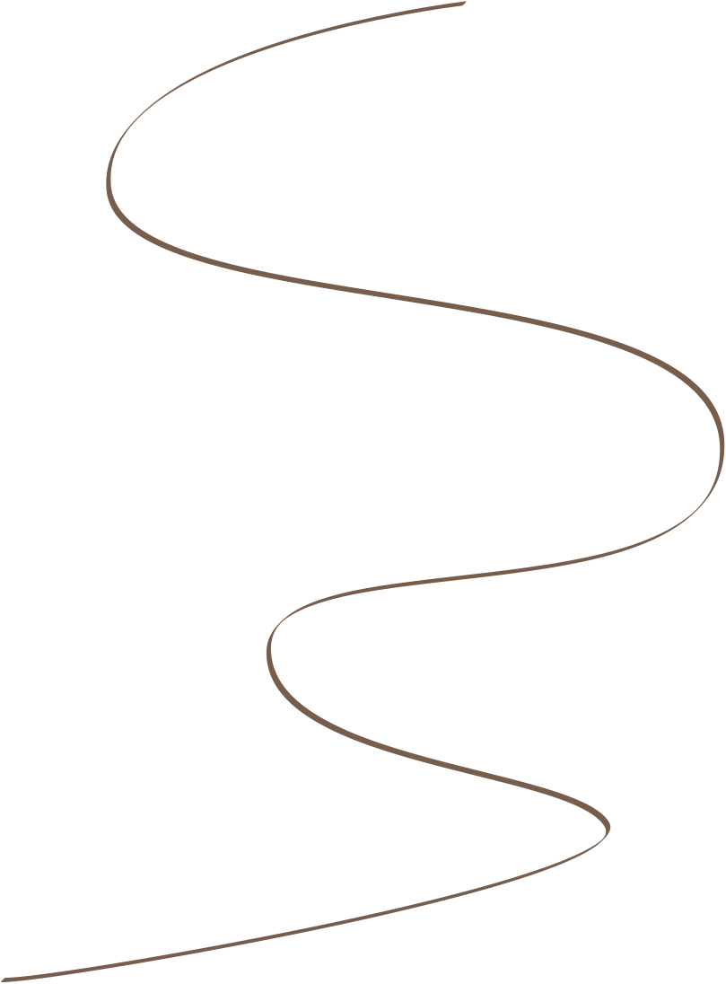
Professionals, this priority.
curev passion
Design to enhance everyday life.
HTM
Following your artwork.
Intrigued by current political affairs around the conduct of american police officers towards black men, researchers at a canadian university conducted a study, in which students wore police-style uniforms.r
[Me/Co-founder/Other Significant Employee] had a major life event — [Wedding/Baby/Marathon]
Created and designed by 荒唐梦.

Slide 4
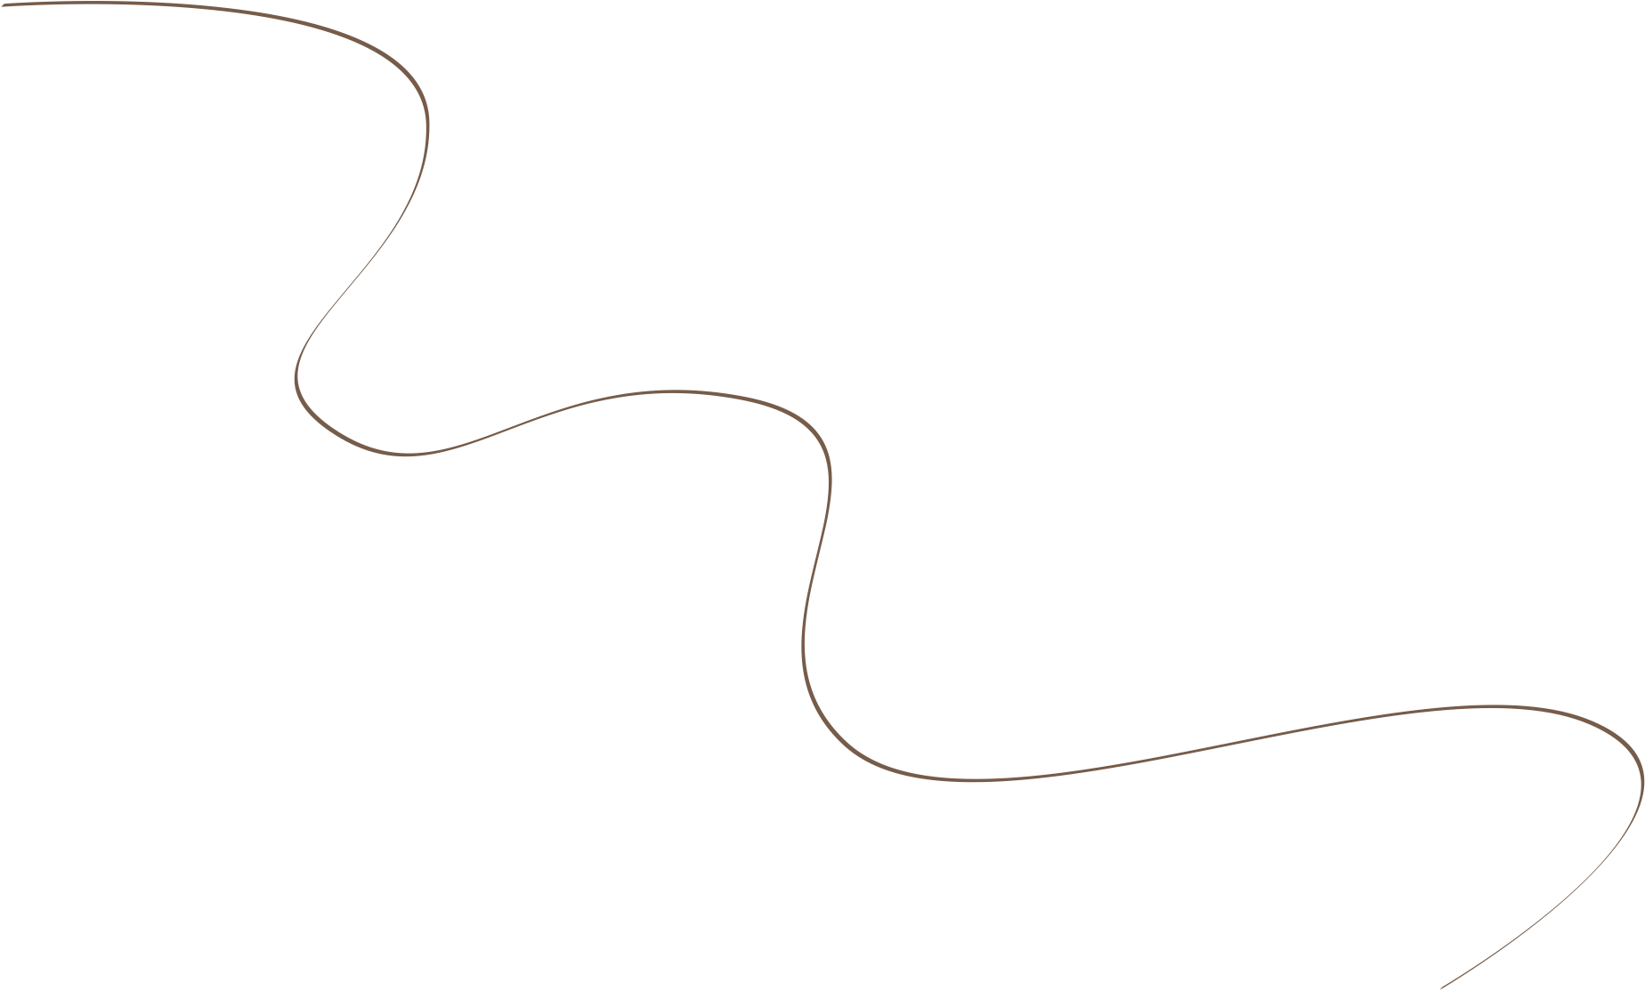
curev passion
For some professionals, this priority can take its toll as it removes the heart and soul from the design process:
Hidden power from inside.
These employees experienced lower job satisfaction and had a negative outlook on their prospects of career progression.
Created and designed by 荒唐梦.

Slide 5
curev passion
But as our (fashion) industry operates in a conventional business model that is product-driven and sales focused first, where does the value of artistic creativity stand?
Written by
Judith Achumba-
Wöllenstein
Potrait.
curev passion
Marketing Strategy
Created and designed by 荒唐梦.

Slide 6
curev passion
Early Upcoming.
“
These employees scored lower on objective job performance evaluations than their peers.
Event.
08:00PM
09:00PM
These employees scored lower on objective job performance evaluations than their peers.
Saturday
Saturday
Created and designed by 荒唐梦.

Slide 7
curev passion
Let’s learn how to make it happen.
Influence behaviour
01
A research project I conducted on the meaning of the clothes associated with a high street brand,
Ultimately shape culture
02
“There is much to support the view that it is clothes that wear us, and not we, them; we may make them, take the mould of arm or breast, but they mould our hearts, our brains, our tongues to their liking.”
The idea that our clothes could assert some sort of influence over our behaviour isn’t groundbreaking. Whenever I tell people that I studied fashion psychology
Created and designed by 荒唐梦.

Slide 8
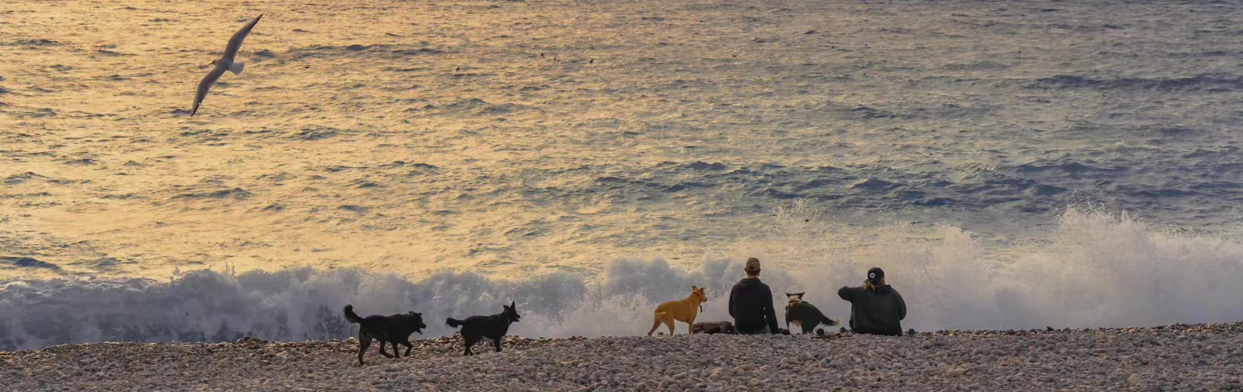
Build interface.
“Fictional names have been used to protect the privacy of participating professionals.”
She expressed that they all somehow shared a lifestyle and certain values, which they felt could be lived out by wearing the brand’s clothing.
It is evident in the way artists help us interpret social justice, and even the way we consume technological innovations and how these have integrated into our everyday lives.
Created and designed by 荒唐梦.

Slide 9
curev passion
Use color pallate.
“
For some professionals, this priority can take its toll as it removes the heart and soul from the design process:
A research project I conducted on the meaning of the clothes associated with a high street brand,
Black
1D34E
RED
1D34E
YELLOW
1D34E
BLUE
1D34E
#1, Cool Company #2 and Cool Company #3].
#1, Cool Company #2 and Cool Company #3].
#1, Cool Company #2 and Cool Company #3].
#1, Cool Company #2 and Cool Company #3].
Showcase your services on a beautiful page just for your workshop or session.
Created and designed by 荒唐梦.

Slide 10
Multipur-
pose presentation.
HTM
It’s been an awesome, but intense, [summer/fall/winter/spring]. Many things are tracking well, but there are some challenges we’re working through.
Get your paid
htm
Clean version
Template
Created and designed by 荒唐梦.

Slide 11
Presentation Template
17
Research.
For some professionals, this priority can take its toll as it removes the heart and soul from the design process:
Concept.
Market.
Design.
For some professionals, this priority can take its toll as it removes the heart and soul from the design process:
A designer who has served the industry for over a decade, I couldn’t help but question if presenting a challenge to the business status quo is equivalent to fighting a losing battle.
Created and designed by 荒唐梦.

Slide 12
Presentation Template
Most of us believe that how we dress is all about expressing to the outside who we are on the inside.
— Jess, Womenswear designer
Clean version
Template
Created and designed by 荒唐梦.

